Slide 1
gRPC - An Introduction
By : Varun Airi
11/26/2020

Slide 2
gRPC = g + RPC
RPC (Remote Procedure Calls )
Calling methods on an object as if it was local (location agnostic)
Fundamental idea behind EJBs, CORBA etc
Stubs:
Representative of service at Client end
Masks Transport
Masks Serialization and Deserialization
Converts to language agnostic interface language
Client
3: Encode response
gRPC
Server
Stub
4: Decode
1: Call Local Method
2: Encode and send over HTTP/2

Slide 3
The Proto(col) Buffer
syntax = "proto3";
option java_package ="the.north.winterfell.rpc.payload";
service Finder {
rpc search (SearchUserRequest) returns (SearchUserResponse) {}
rpc repeatedSearch (SearchUserRequest) returns (stream SearchUserResponse){}
}
message SearchUserRequest{
string userName=1;
int32 userId=2;
}
message ResultStatus{
string errorCode=1;
string errorMessage=2;
int32 level=3;
}
message User{
string userId=1;
string userName=2;
string country=3;
int32 age=4;
}
message SearchUserResponse{
repeated ResultStatus resultStatusArr=1;
User user=2;
}
Default in gRPC
Encoded efficient Serialization
.proto files
Think of it as a Schema/ WSDL/ Interface Definition
Defines the messages / Vos
Defines the Services
Defines Methods in services including parameters, return types etc.

Slide 4
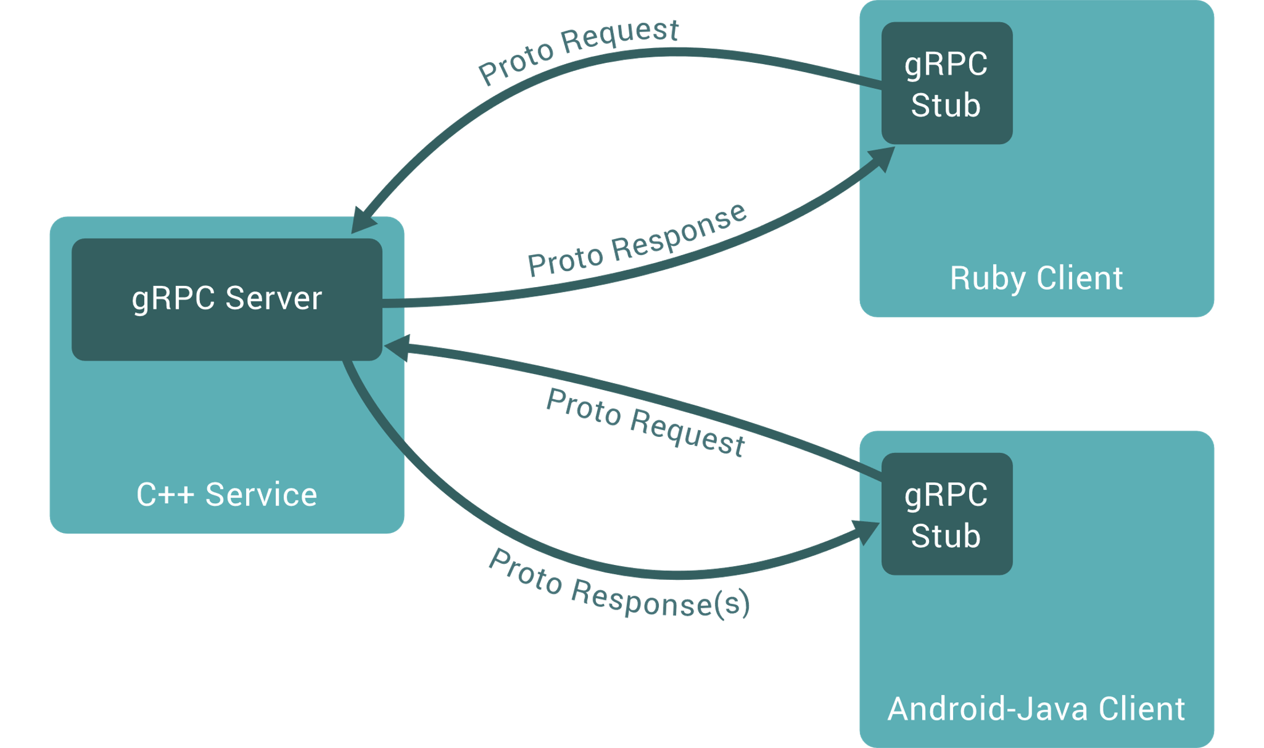
The Service
Defined in .proto file
Multiple Flavors
Synchronous Client / Server
Server Streaming Service
Client Streaming Service
Both Sides Streaming
Synchronous and Asych
Either party can
Cancel the RPC, does not result in Rollback
Determine Success/failure.
Client can set the deadlines

Slide 5
Why gRPC?
Proto Buffers
Fast
Compression and encoded for bigger payloads
Strongly Typed
Enforce Contract between Client and Server
HTTP/2 Based
1 TCP Connection that stays open
Multiplexing
Compression
Bidirectional Streaming
Server push

Slide 6
When should I use gRPC
Typical Use Cases
IoT (Low Resources, N/w Requirements)
Audit Logging (Big JSON/XMLs over N/W)
Requiring Strict Contract
Cons
Not as easy as REST, messages are not human / browser readable.
REST Standard Verbs and error codes are standards, but no such standards here.
Deployment may be tricky with K8S
Tooling Support for Java, JavaScript
Swagger

Slide 7
Steps to implement gRPC Server and Client
Prerequisites
Write a .proto file defining message and Service Type
Compile the proto into .class files (Easiest is through Maven) generating stubs
Distribute the JAR to Server and Client
Client
Create a message channel
Create a Stub Object
Call method
Handle Response
Server
Server extends the Service Class from JAR and provide implementations for Streaming/ Unary RPC Service
Also starts the server at designated port

Slide 8
Further Reading
https://grpc.io/docs
https://medium.com/expedia-group-tech/introducing-grpc-to-our-hotels-com-platform-part-1-61716af50b13
https://codelabs.developers.google.com/codelabs/cloud-grpc-java
https://developers.google.com/protocol-buffers/docs/tutorials

